Slide 1
Tenants
Feature and Architecture

Slide 2
Introduction
The Tenants page allows the Service Provider to view, create ,edit or delete their new or existing tenants.
The new/edit form allows the Service Provider to update the following information:
general tenant information
contact details
installation settings.

Slide 3
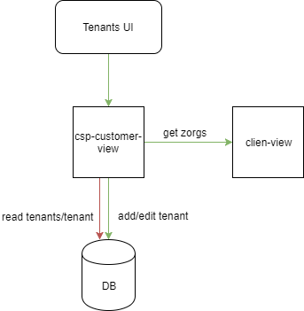
Architecture
The Tenants UI communicates with a dedicated service named csp-customer-view.
The service inserts or pulls the data to a dedicated collection named csp-customers in the DB

Slide 4
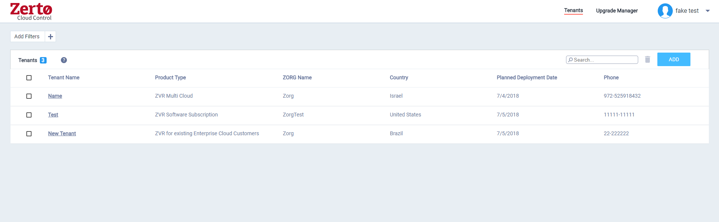
Main Flow – view The existing tenants list in the UI gets data from the "get tenants" REST API

Slide 5
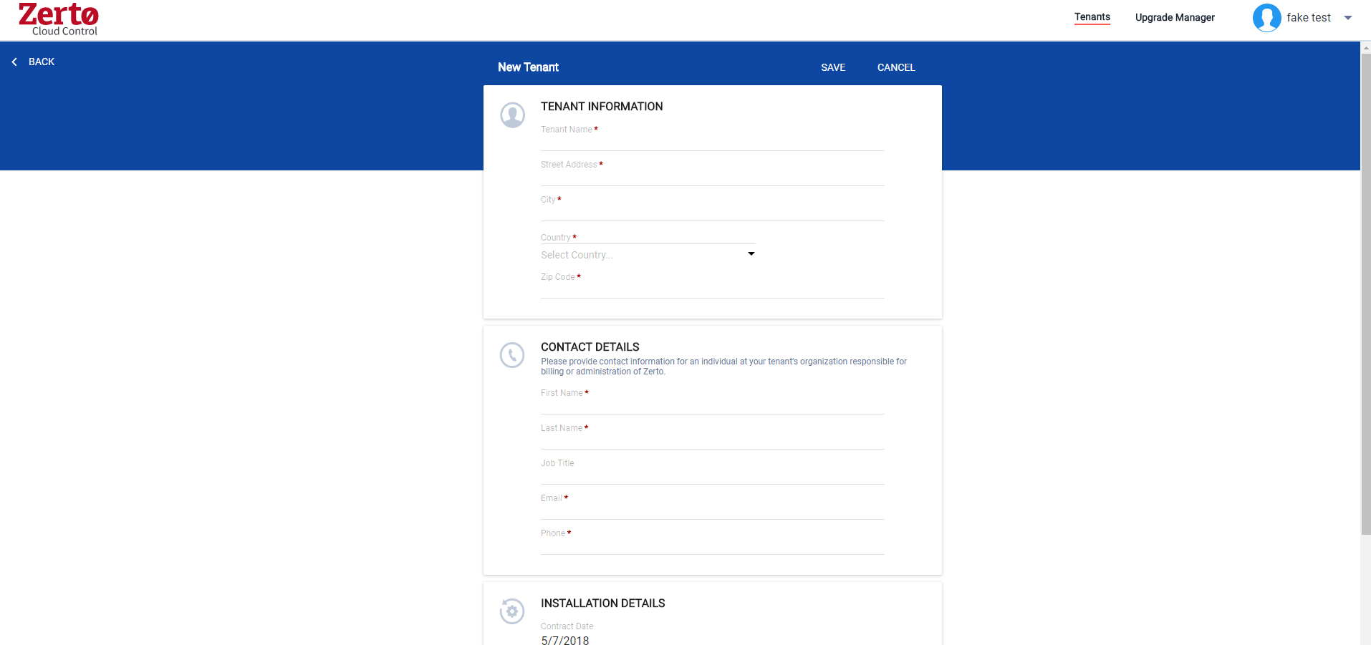
Add Tenant Flow
To add a new tenant the UI send a POST request to "add new tenant " service.
If the zorg list is empty , you can enter a new Zorg name in the text field.

Slide 6
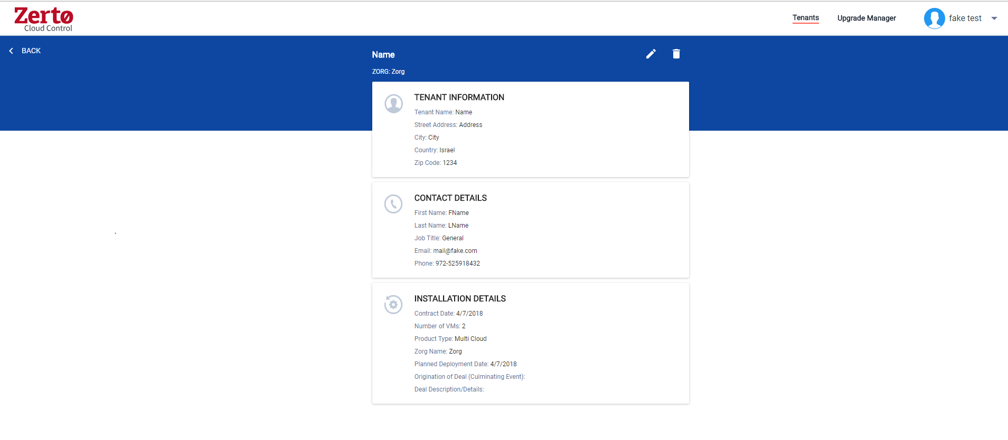
Edit and delete Flow • In order to edit a tenant the UI gets the tenant data from "get tenant" service. • To edit the tenant click on the pencil. Edit will use the "update tenant" service. To delete a tenant , click on the trash can icon,

Slide 7
Authentication & Authorization
In order for an account manager to enter the tenants page it must have a SF account, he should be a MyZerto User. And in his Cognito attributes it should have the following attribute:
Custom:CompanyType:cloud_provider
MyZerto -> User (update SF)
SF -> Account
SF -> User -> Attributes
AWS Cognito -> Builds the JWT (a job that retrievs data from Sales Force)
User Attributes
Custom:CompanyType:cloud_provider

Slide 8
Masquerading
Masquerading (impersonating) is a feature built in so a user can get information (and thus view the UI) of any account ID in the system.
Do not let the customers know of this feature!
This feature works by adding the query ?aid=<account-id>to the end of the URL on the browser.

Slide 9
Problems which an account manager can encounter
A screen with an error on the list of tenants appears: check the JWT Token attributes for the account manager.
Entering values in the form and clicking Save button doesn’t work: 1.Check if all the fields you entered are valid.
2.Could be that the service is down, check the service logs.
Zorg list in the Add tenant form is empty:
1. Could be that there are no zorgs in zcm for this cloud manager
2. Check if the relevant zvm's transmit their zorgs data (from version 5.u4)

